Slide 1
Intro to Supervised Learning
Lesson 19.1

Slide 2
Class Objectives
By the end of this lesson, you will be able to:
Explain how machine learning algorithms are used in data analytics.
Create training and testing sets from a specified data set.
Implement linear and logistic regressions by using scikit-learn.
Create confusion matrices for classification outputs.
Notes:
Fix matrices spelling in LP

Slide 3
Demystifying Machine Learning
Notes:
1.1

Slide 4


Instructor Do: Demystifying Machine Learning
Notes:
1.1
shutterstock_1006201120

Slide 5

Instructor Do: Demystifying Machine Learning
Machine Learning Algorithms
Machine Learning algorithms are functions with internal parameters that apply labels to data points.
Σ
β₀
λ
A | B | C | D
10 | 15 | 23 | 12
Data Point
Machine Learning Algorithm
Label
Notes:
1.1

Slide 6

Instructor Do: Demystifying Machine Learning
But What is it Learning?
Training Data
Machine Learning algorithms use training data to set their internal parameters. This is the “learning” of Machine Learning.
Σ
β₀
λ
A | B | C | D
10 | 15 | 23 | 12
Data Point
Machine Learning Algorithm
Label
Notes:
1.1

Slide 7

Instructor Do: Demystifying Machine Learning
Machine Learning Categories
Dimensionality Reduction
Meaningful Compression
Big Data Visualization
Structure Discovery
Feature Elicitation
Image Classification
Identity Fraud Detection
Customer Retention
Diagnostics
Classification
Unsupervised Learning
Supervised Learning
Machine Learning
Clustering
Recommender Systems
Targeted Marketing
Customer Segmentation
Regression
Population Growth Prediction
Advertising Popularity Prediction
Weather Forecasting
Market Forecasting
Estimating Life Expectancy
Reinforcement Learning
Real-time decisions
Robot Navigation
Game AI
Skill Acquisition
Notes:
1.1

Slide 8

Instructor Do: Demystifying Machine Learning
Supervised Learning
Succinctly, supervised learning is algorithms for which the potential outcomes are knowable in advance (i.e., category or numeric range) and can be used to correct the model’s predictions.
01
Example
02
Example
Using data such as credit score, credit history, income, etc., we are trying to predict whether an individual is a credit risk or not.
Using features such as number of bedrooms, square feet, etc, we are trying to predict the market value of a house.
Known Category:
“Credit Risk” vs. “Not Credit Risk”
Numeric Range:
50,000 - 500,000
Notes:
1.1

Slide 9
Instructor Do: Demystifying Machine Learning
Supervised Learning Subcategories
Dimensionality Reduction
Meaningful Compression
Big Data Visualization
Structure Discovery
Feature Elicitation
Classification: Applying labels to data
Image Classification
Identity Fraud Detection
Customer Retention
Diagnostics
Unsupervised Learning
Supervised Learning
Machine Learning
Clustering: Finding groups within
a population
Regression:
Fitting data to predict where a new data point lies
Recommender Systems
Targeted Marketing
Customer Segmentation
Population Growth Prediction
Advertising Popularity Prediction
Weather Forecasting
Market Forecasting
Estimating Life Expectancy
Reinforcement Learning
Real-time decisions
Robot Navigation
Game AI
Skill Acquisition
Notes:
1.1

Slide 10
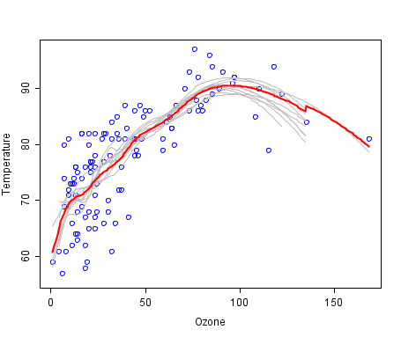
Instructor Do: Demystifying Machine Learning
Supervised Learning
Regression
We’ll be revisiting regression to predict the location of data points based on old data.
Notes:
1.1

Slide 11
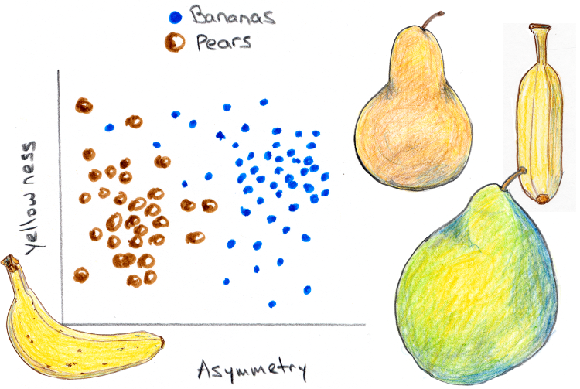
Instructor Do: Demystifying Machine Learning
Supervised Learning
Classification
Notes:
1.1

Slide 12

Instructor Do: Demystifying Machine Learning
Unsupervised Learning
Algorithms for which the potential outcomes are unlabeled. Inferences are made directly from the data without feedback from known outcomes or labels.
Notes:
1.1
shutterstock_790790974

Slide 13
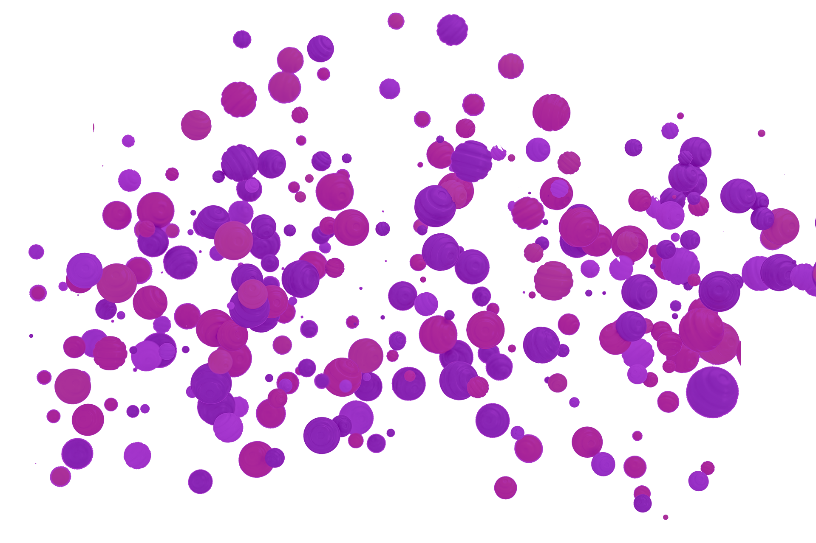
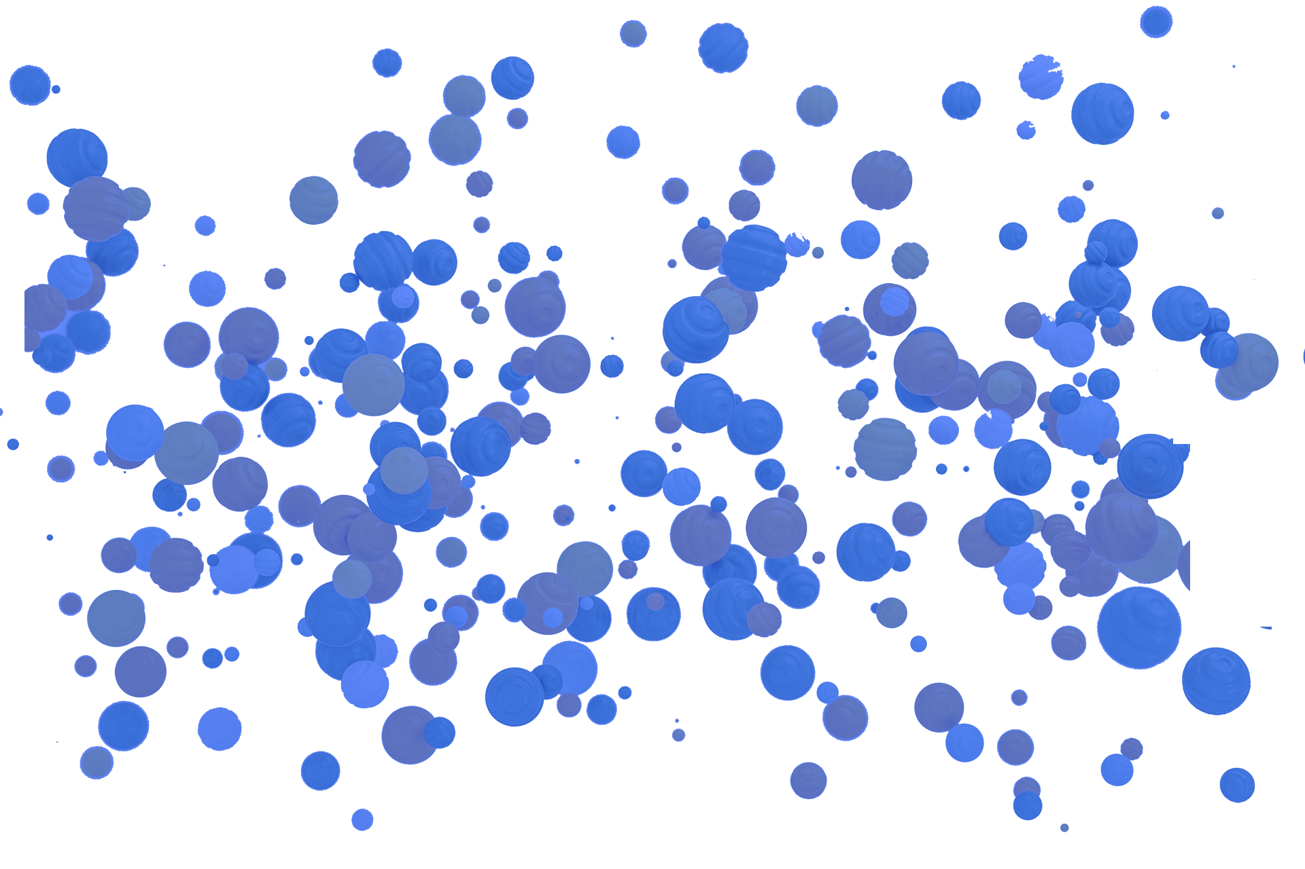
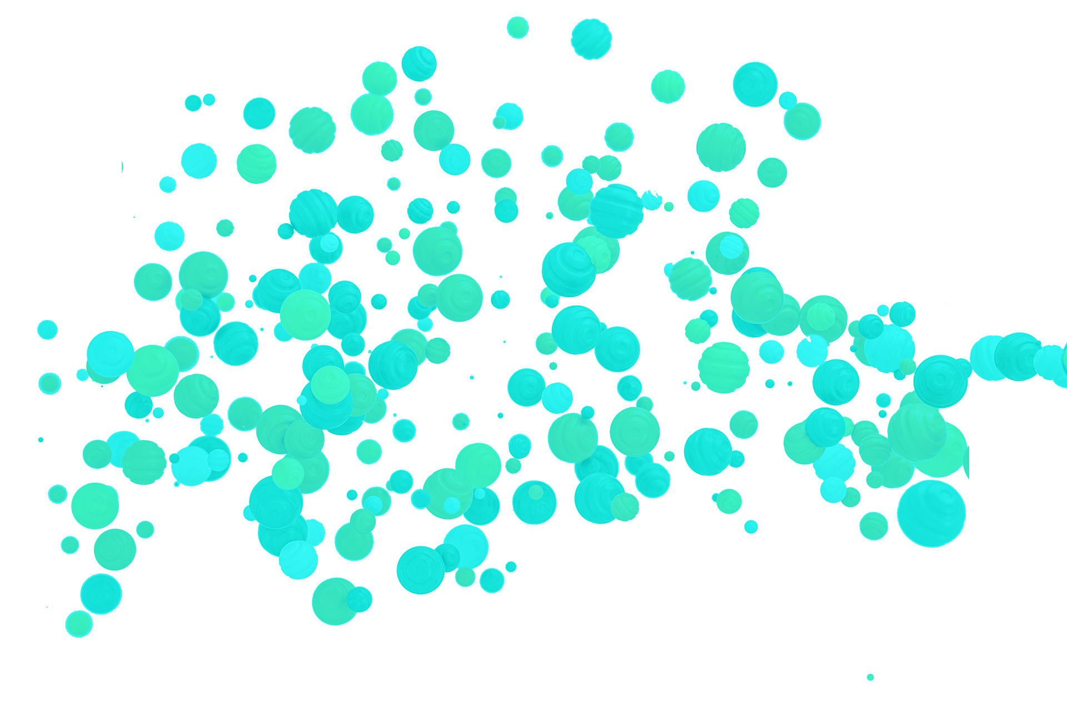
Instructor Do: Demystifying Machine Learning
Unsupervised Learning
Clustering
In this clustering problem, we expect our algorithm to group data points based on their mutual similarities of features.
60
60
50
50
40
40
30
30
20
20
10
10
10 20 30 40 50 60 70 80 90 100
10 20 30 40 50 60 70 80 90 100
K=3
Notes:
1.1

Slide 14
Instructor Do: Demystifying Machine Learning
Unsupervised Learning
Clustering
But the problem is more complex.
60
50
40
30
20
10
K=2
10 20 30 40 50 60 70 80 90 100
Notes:
1.1

Slide 15
Instructor Do: Demystifying Machine Learning
Unsupervised Learning
Clustering
Perhaps the clusters are not where we think they are.
60
50
40
30
20
10
K=2
10 20 30 40 50 60 70 80 90 100
Notes:
1.1

Slide 16
Instructor Do: Demystifying Machine Learning
Model → Fit(Train) → Predict
Regardless of the problem type, in Machine Learning we follow a familiar paradigm.
Machine Learning
Predict
Data
Fit
Query
Decision
Application
Model
Notes:
1.1
This diagram was created for Trilogy and does not violate copyright.

Slide 17

Instructor Do: Demystifying Machine Learning
Model → Fit(Train) → Predict
Regardless of the problem type, in Machine Learning we follow a familiar paradigm.
A | B | C | Class
11 | 16 | 22 | 1
10 | 8 | 4 | 2
… | … | … | …
A | B | C | Class
10 | 15 | 23 | ?
Apply
Class
1
Fit
Model
Predict
Notes:
1.1
This diagram was created for Trilogy and does not violate copyright.

Slide 18
Notes:
1.1

Slide 19
Linear Regression
Notes:
1.2

Slide 20

Q
What is linear regression?
Notes:
1.2

Slide 21
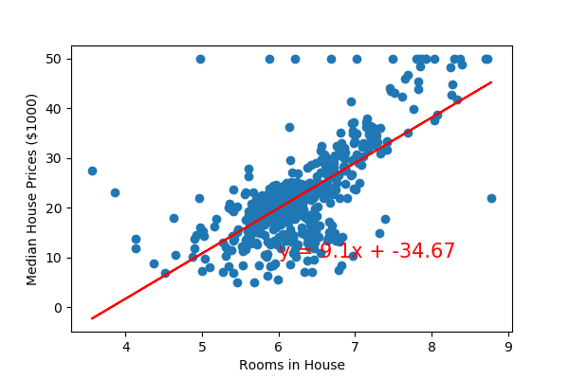
Instructor Do: Linear Regression
Linear Regression
Linear regression is used to model and predict a relationship.
Predicts a dependent variable, given values from an independent variable.
There are two basic types.
Simple linear regression.
Multiple linear regression.
Both types predict an independent variable using the linear equation.
Notes:
1.2

Slide 22
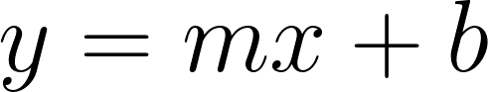
Instructor Do: Linear Regression
The equation of a line - Univariate
Slope
y-intercept
Dependent variable
Independent variable
Notes:
1.2

Slide 23
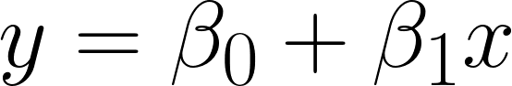
Instructor Do: Linear Regression
The equation of a line - Univariate in Greek!
Slope
y-intercept
Dependent variable
Independent variable
Notes:
1.2

Slide 24

Instructor Do: Linear Regression
The equation of a line - Multivariate
y-intercept
Slopes (Coefficients)
Dependent variable
Independent variables
Notes:
1.2

Slide 25
Linear regression is FAST
Notes:
1.2

Slide 26
Activity: Linear Regression
In this activity, you will calculate two regression lines by using a dataset of California house prices. For the first regression line, you'll explore the relationship between median income levels and median home values. For the second regression line, you'll use all the available variables to predict the median home value.
15 Minutes
Notes:
1.3

Slide 27
Activity: Linear Regression
Instructions:
For univariate regression:
Load the housing data, and then separate the median income feature into one variable: med_inc.
Create a scatter plot of med_inc vs. y (median home values) to visually find out if any linear trend exists.
Use the linear regression model of Sklearn to fit the model to the data.
Print the weight coefficients and the y-axis intercept for the training model.
Calculate the y_min and y_max values by using model.predict().
Plot the model fit line by using [x_min[0], x_max[0]], [y_min[0], y_max[0]].
For multivariate regression:
Use the linear regression model of Sklearn to perform multiple linear regression by using all eight features for X and median home value for y.
Compute the R2 score for the training and the testing data separately.
Plot the residuals for the training and the testing data.
Notes:
1.3

Slide 28
Notes:
1.4

Slide 29
Quantifying Regression
Notes:
2.1

Slide 30
Instructor Do: Quantifying Regression
Common Scoring Metric
01
R² (R-Squared):
02
MSE (Mean Squared Error):
This is the baseline metric that many ML tools report on score. Higher R² values signify that the model is “highly predictive.” An R² value of >0.90 means that our model roughly accounts for 90% of the variability of the data.
This measures the average of the squares of the eros or deviations.
Notes:
2.1

Slide 31
Instructor Do: Quantify Regression
Basic Premise of Validation Using Training/Testing Data
We will cut a slice of this data (80%) to build our model, and then use this slice to predict the values for the remaining 20%.
Full Data Set (Historic)
N=1000
# bedrooms | # baths | Sq. feet (k) | Price (k)
2 | 1 | 1 | 200
3 | 2 | 1.5 | 250
… | … | … | …
Training Data Set
N=800
# bedrooms | # baths | Sq. feet (k) | Price (k)
4 | 3.5 | 3.2 | 450
2 | 2 | 1.5 | 220
… | … | … | …
Testing Data Set
N=200
# bedrooms | # baths | Sq. feet (k) | Price (k)
1 | 1 | .5 | 60
5 | 3.5 | 4.2 | 780
… | … | … | …
Fit
Model
Predict
Notes:
2.1

Slide 32
Instructor Do: Quantifying Regression
Basic Premise of Validation: Training
We use the training data to fit the model to the data. This is the training step where we build a model that can predict our output (home price) for a given set of features (# bedrooms, # baths, square feet). Once the model is trained, we can use the model to make predictions.
Full Data Set (Historic)
N=1000
# bedrooms | # baths | Sq. feet (k) | Price (k)
2 | 1 | 1 | 200
3 | 2 | 1.5 | 250
… | … | … | …
Training Data Set
N=800
# bedrooms | # baths | Sq. feet (k) | Price (k)
4 | 3.5 | 3.2 | 450
2 | 2 | 1.5 | 220
… | … | … | …
Testing Data Set
N=200
# bedrooms | # baths | Sq. feet (k) | Price (k)
1 | 1 | .5 | 60
5 | 3.5 | 4.2 | 780
… | … | … | …
Fit
Model
Predict
Notes:
2.1

Slide 33
Instructor Do: Quantifying Regression
Basic Premise of Validation
We use the test data to make new home price predictions. We can then compare the home price of our prediction vs. the actual price. Based roughly on how often we are “correct,” we get a score for the model as a whole. If the model scores well, we can trust it for future use. We train the model on the training data and score the model based on data that it has never seen before (test data).
Full Data Set (Historic)
N=1000
# bedrooms | # baths | Sq. feet (k) | Price (k)
2 | 1 | 1 | 200
3 | 2 | 1.5 | 250
… | … | … | …
Training Data Set
N=800
# bedrooms | # baths | Sq. feet (k) | Price (k)
4 | 3.5 | 3.2 | 450
2 | 2 | 1.5 | 220
… | … | … | …
Testing Data Set
N=200
# bedrooms | # baths | Sq. feet (k) | Price (k)
1 | 1 | .5 | 60
5 | 3.5 | 4.2 | 780
… | … | … | …
Fit
Model
Predict
Notes:
2.1

Slide 34
Notes:
2.1

Slide 35
Activity: Brains!
In this activity, you will calculate a regression line to predict head size vs. brain weight.
15 Minutes
Notes:
2.2

Slide 36
Activity: Brains!
Instructions:
Start by creating a scatter plot of the data to visually find out if any linear trend exists.
Split the data into training and testing data by using the sklearn train_test_split() function.
Use the linear regression model of sklearn to fit the model to the training data.
Use the test data to make new predictions. Calculate the mean squared error (MSE) and the R-squared (R2) score for those predictions.
Use model.score() to calculate the R2 score for the test data.
Notes:
2.2

Slide 37
Notes:
2.3

Slide 38

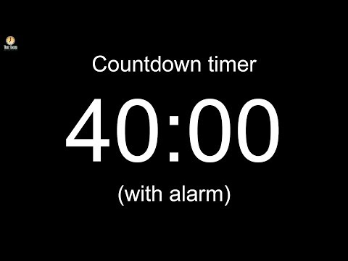
Notes:
Image source: AdobeStock_56885471

Slide 39
Logistic Regression
Notes:
3.1

Slide 40
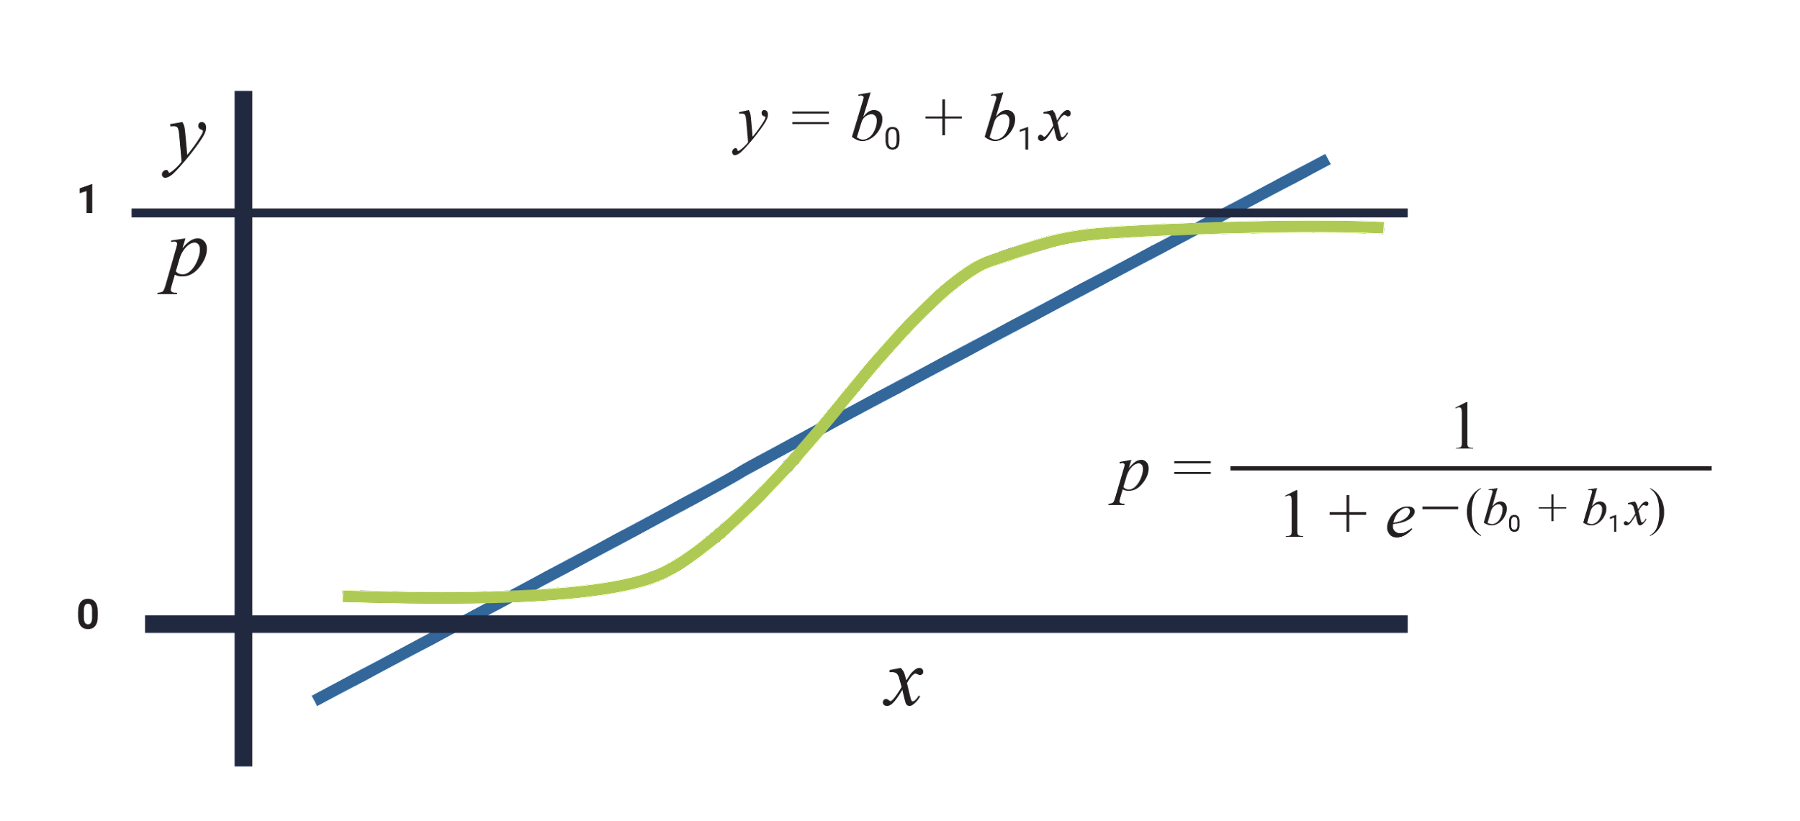
Instructor Do: Logistic Regression
Logistic Regression
Logistic regression is a classification algorithm used to predict a discrete set of classes or categories (e.g., Yes/No, Young/Old, Happy/Sad).
Unlike linear regression, which outputs continuous numerical values (for example, age), logistic regression applies an activation function, such as the sigmoid function, to return a probability value of 0 or 1. This can then be mapped to a discrete class like “Young” or “Old.”
Linear Model
Logistic Model
Notes:
3.1

Slide 41


Instructor Do: Logistic Regression
Predicting a discrete output or category (Classification)
Bias
Activation
Function
Happy
X
Sad
Linear Model
Logistic Model
Discrete Output 0 or 1 “Happy“ or “Sad”
Notes:
3.1

Slide 42
Activity: Counterfeit Catcher
In this activity, you will apply logistic regression to predict whether a particular note is counterfeit or legitimate by using computed features from digitized images.
20 Minutes
Notes:
3.2

Slide 43
Activity: Counterfeit Catcher
Instructions:
Split your data into training and testing data.
Create a logistic regression model with sklearn.
Fit the model to the training data.
Make 10 predictions, and then compare them to the testing data labels.
Compute the accuracy score for the training data and the testing data separately.
Notes:
3.2

Slide 44
Notes:
3.3

Slide 45
Confusion Matrix
Notes:
4.1

Slide 46
Instructor Do: Confusion Matrix
What is a Confusion Matrix?
A Confusion Matrix compares the predicted values from a model against the actual values. The entries of the confusion matrix are the number of True Positives (TP), True Negatives (TN), False Positives (FP), and False Negatives (FN).
 | Predicted True | Predicted False
Actually True | 113 (True Positives) | 12 (False Negatives)
Actually False | 31 (False Positives) | 36 (True Negatives
Notes:
4.1

Slide 47
Instructor Do: Confusion Matrix
What is a Confusion Matrix?
We can calculate measures like the accuracy of a model from the values in the confusion matrix.
Accuracy = TP + TN / (TP + TN + FP + FN)
We can also calculate other measures that gives us more information that just the accuracy, such as:
Precision
Sensitivity
F1 Score
Positive Predictive Value
Negative Predictive Value
Threat Score
False Omission Rate
Notes:
4.1

Slide 48
Notes:
4.1

Slide 49
Activity: Create a Confusion Matrix
In this activity, you will create a confusion matrix from the results of the previous activity and then manually calculate the accuracy of the model.
10 Minutes
Notes:
4.2

Slide 50
Activity: Create a Confusion Matrix
Instructions:
Open Stu_Confusion_Matrix.ipynb (or use the solved notebook from the previous activity), and then create a confusion matrix for the testing dataset.
From the values in the confusion matrix, manually calculate the accuracy of the model.
Notes:
4.2

Slide 51
Notes:
4.3

Slide 52
Grid Search and Randomized Search
Notes:
5.1

Slide 53
Instructor Do: Grid Search and Randomize Search
Hyperparameters
Simply put, hyperparameters allows you to customize how algorithms behave to a specific dataset.
Different from parameters, hyperparameters are specified by you and not by an internally learning algorithm.
Picking the best hyperparameters for a model can be difficult, therefore we use random or grid search strategies for optimal values.
Notes:
5.1

Slide 54
Instructor Do: Grid Search and Randomize Search
Tuning Hyperparameters
Via Grid Search:
A brute-force search paradigm approach where we specify a list of values for different hyperparameters, left for the computer to evaluate the model performance for each combination of those to obtain the optimal set.
Via Random Search:
Similar to a grid search in many different ways, we still define an estimator, which hyperparameters to tune and the range of values for each hyperparameter. Also, we still set a cross-validation scheme and scoring function. Nevertheless, when it comes to undertake the search, rather than trying every single combination, you randomly sample N combinations and try these out.
Notes:
5.1

Slide 55
Notes:
5.1

Slide 56
Activity: Grid Search
In this activity, you will use GridSearchCV() and RandomizedSearch() to choose the parameters for a logistic regression model on the Pima Diabetes dataset.
15 Minutes
Notes:
5.2

Slide 57
Activity: Grid Search
Instructions:
Use the provided starter code, and apply GridSearchCV() and RandomizedSearchCV() to a logistic regression model. Change the C and tol parameters.
Note that you can use any values that you want to try, but the notebook comments include suggested values.
Print the best parameters and the best score for both tuned models.
Calculate the predictions by using one of the tuned models and the X_test data, and then print the classification report.
Notes:
5.2

Slide 58
Notes:
5.3

